Slide 1
NextHikes IT Solution: Exploratory Data Analysis (EDA) for Real Estate Pricing
AVANTIKA VERMA

Slide 2
AGENDA
PROJECT OVERVIEW
DATA ANALYSIS
VISUALIZATIONS
FEATURE ENGINEERING
MODEL BUILDING
MODEL COMPARISON
CUSTOMER FEEDBACK
HOUSE PRICE PREDICTION MODEL
CUSTOMER FEEDBACK ANALYSIS

Slide 3
PROJECT OVERVIEW
This project presents an Exploratory Data Analysis (EDA) and the development of a predictive model for housing price prediction using a real estate dataset.
The analysis covers key tasks such as data preprocessing, missing value handling, feature engineering, correlation analysis, outlier detection, and model evaluation.
The goal is to predict housing prices using various factors such as location, house features, and overall quality.

Slide 4
DATA ANALYSIS PHASE
Data Exploration
Dataset Overview
Total Entries: 1460
Total Features: 81
Data Types:
Numerical Features: 36
Categorical Features: 45
Target Variable: SalePrice
Key Objective: Predict housing prices based on various property characteristics.
Missing Value Analysis
Alley (93.77%) → Dropped.
PoolQC (99.52%) → Dropped due to the low presence of pools.
GarageYrBlt (5.55%) → Imputed using the median value of the garage construction year.
MasVnrType (59.73%) → Imputed based on MasVnrArea.

Slide 5
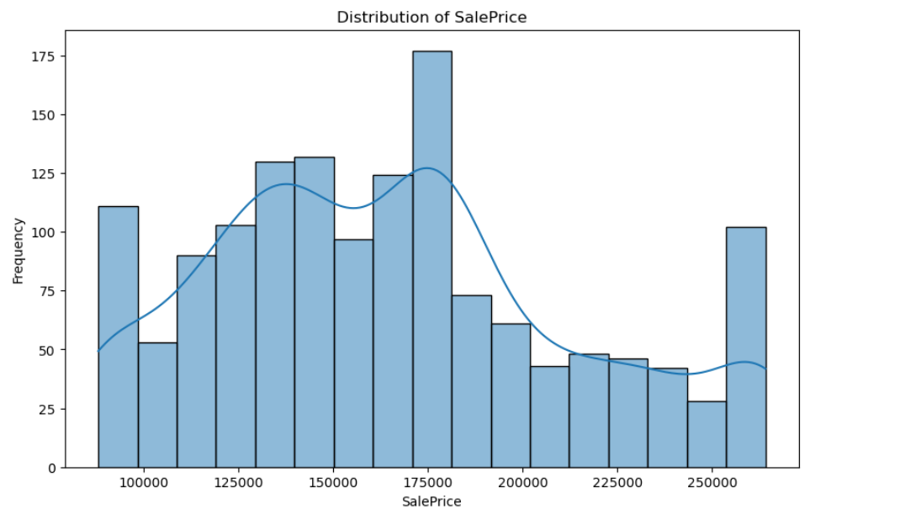
DISTRIBUTION OF SALE PRICE
Distribution Shape:
The distribution appears right-skewed (positively skewed).
This suggests that while most homes have relatively lower prices, a few expensive homes drive the higher-end tail.
Peaks & Mode:
The distribution has multiple peaks, indicating that sale prices are not normally distributed.
The most frequent sale price range appears to be around $175,000, where the highest bar is observed.
Outliers & Spread:
There are homes with much higher prices, as seen in the tail of the distribution.

Slide 6
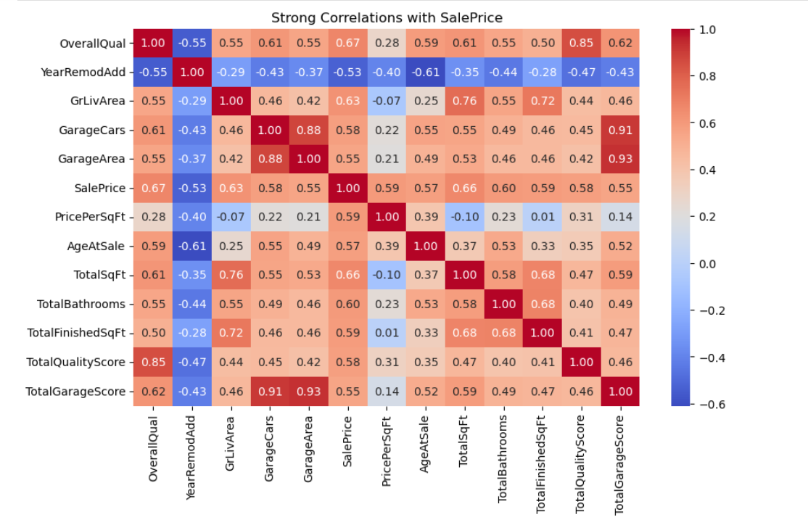
Strong co relations with sale price
The key insights from the heatmap:
SalePrice is highly correlated with Overall Quality (0.67), GrLivArea (0.63), and TotalSqFt (0.66)—larger, high-quality homes sell for more.
Garage space matters (GarageCars: 0.58, GarageArea: 0.55).
Older homes tend to sell for less (AgeAtSale: -0.61).
TotalBathrooms (0.60) and TotalQualityScore (0.58) also strongly impact price.

Slide 7
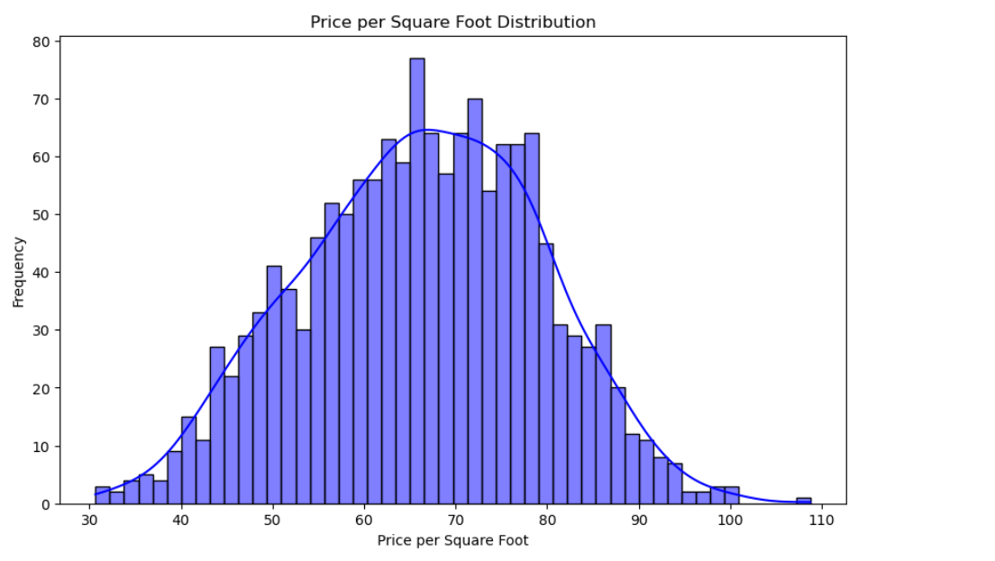
Distribution of price per square foot
Key Insights from the Price per Square Foot Distribution:
Right-Skewed Distribution: Most properties fall within a typical range, but some high-priced outliers push the tail to the right.
Peak Price Range: The most frequent price per square foot is around $65–$70, indicating the typical cost for most homes.
Spread of Prices: Prices generally range between $30 and $100 per square foot, with fewer properties exceeding $90.
Potential Outliers: The presence of high-value properties suggests some premium real estate in the dataset.

Slide 8
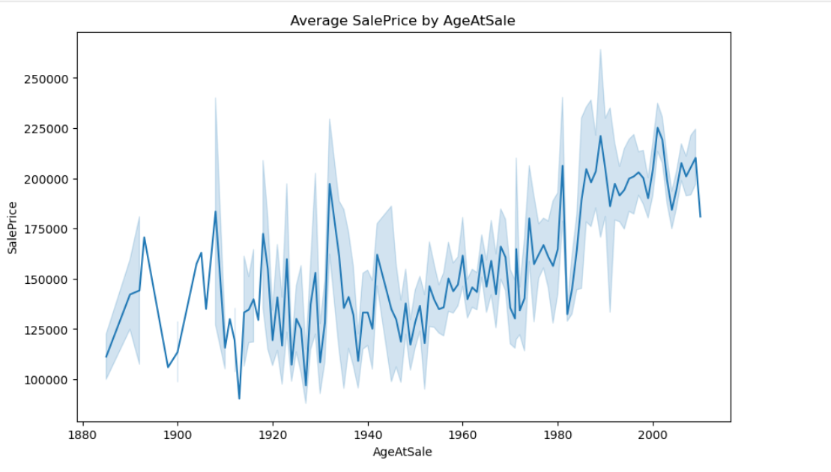
Distribution of average sale price by age of property
Key Insights from the "Average SalePrice by AgeAtSale" Plot
Overall Upward Trend: The average sale price has generally increased over time, particularly for homes built after 1980.
High Variability: There is significant fluctuation in sale prices, especially for older properties (pre-1950), as shown by the wide confidence band.
Dip for Mid-Century Homes: Homes built around 1940–1970 appear to have relatively lower sale prices compared to newer homes.
Recent Homes Fetch Higher Prices: Properties built after 1980 tend to have higher average sale prices, reflecting modern construction quality, amenities, and possibly demand.

Slide 9
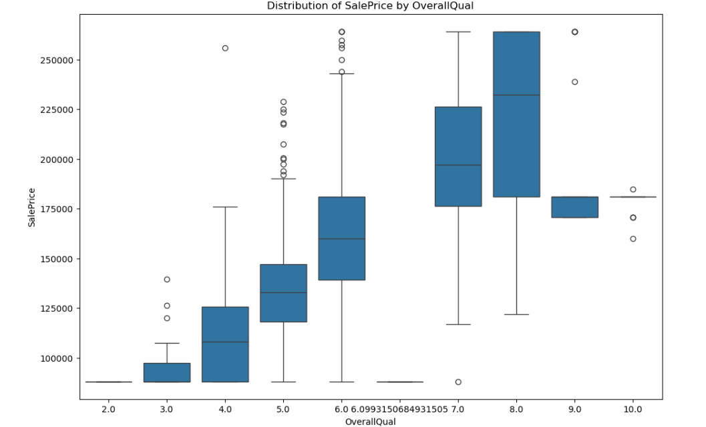
Distribution of sale price by overall quality
Key Insights:
Higher Quality, Higher Price: Sale price increases with OverallQual.
Wider Price Spread for High Quality: More variation in prices for better-quality homes.
Outliers Exist: Some low-quality homes have high prices and vice versa.
Strong Correlation: Quality is a key factor in home pricing.

Slide 10
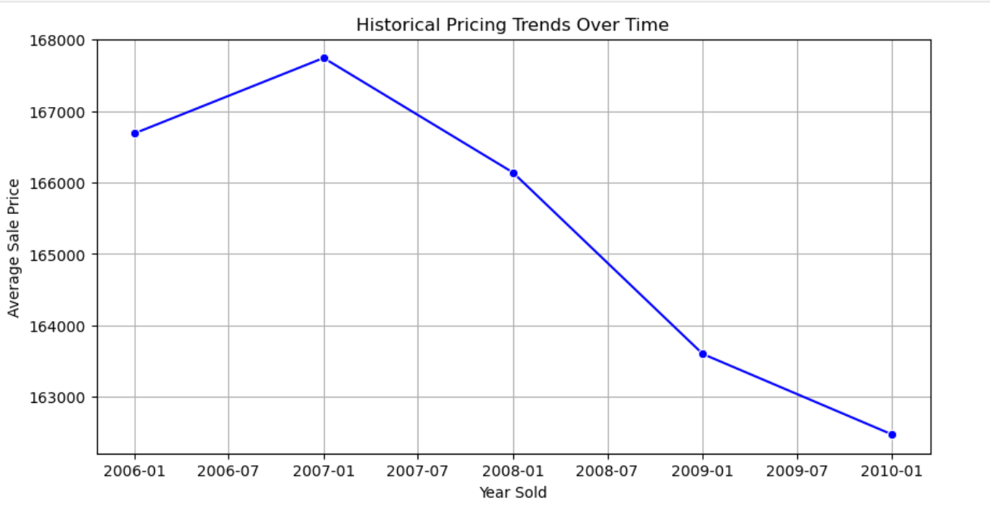
HISTORICAL PRICING TRENDS
KEY INSIGHTS:
Peak in 2007: Average sale prices increased until 2007.
Declining Trend: Prices dropped consistently from 2008 to 2010.
Possible Market Crash Effect: The decline aligns with the 2008 financial crisis.
Steady Downward Slope: No sign of recovery by 2010

Slide 11
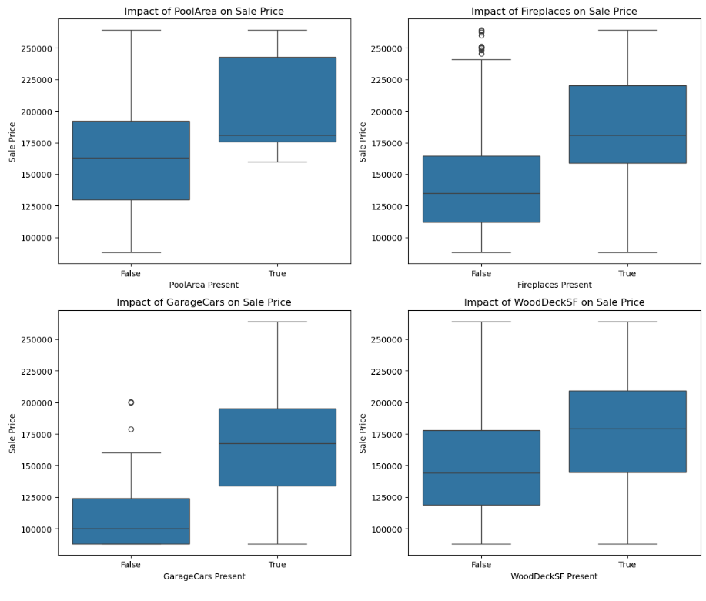
CUSTOMER PREFERENCE AND AMENITIES
Impact of Amenities on House Prices
Pool Area- Homes with a swimming pool tend to have higher sale prices. However, since pools are relatively rare, the effect may be pronounced but less frequent.
Fireplaces- Houses with at least one fireplace show higher median prices than those without, indicating that buyers have a preference for fireplaces.
GarageCars- More garage space correlates with higher house prices. Additional parking/storage space is seen as valuable by buyers.
WoodDeckSF- Properties with a wooden deck tend to sell for higher prices, suggesting that outdoor living spaces are highly desirable.

Slide 12
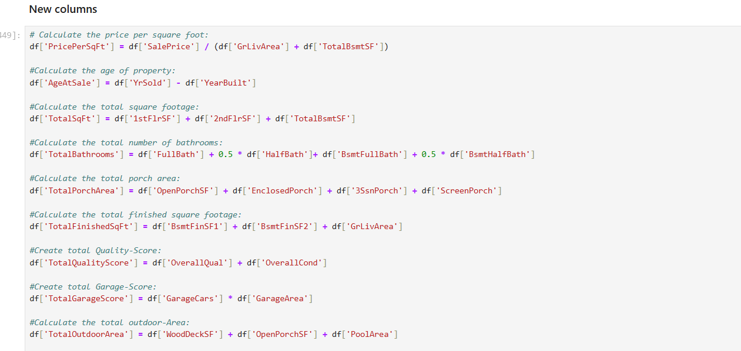
FEATURE ENGINEERING

Slide 13
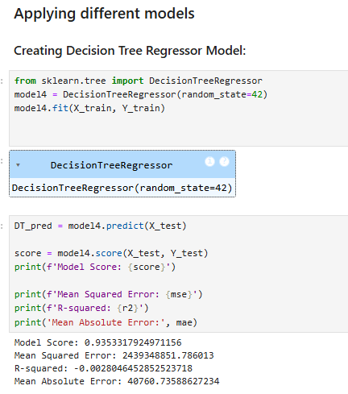
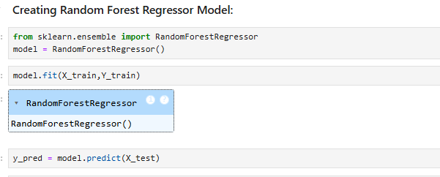
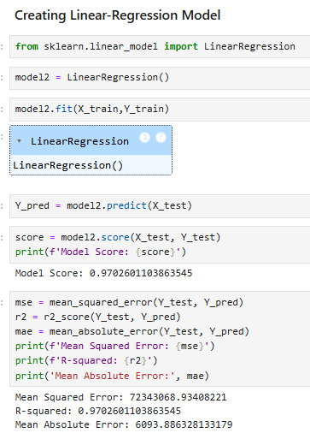
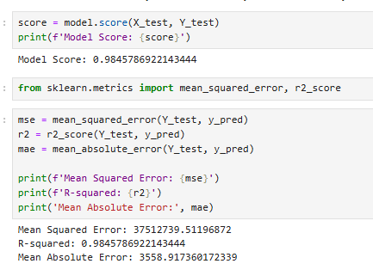
MODEL BUILDING

Slide 14
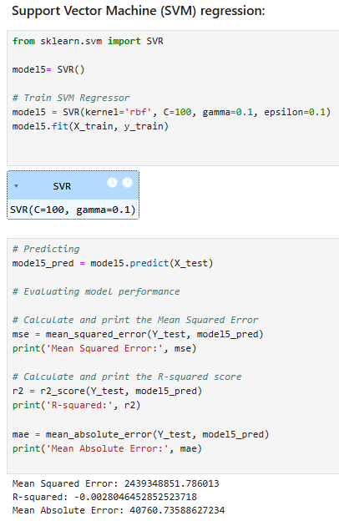
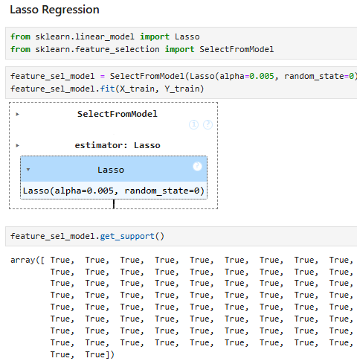
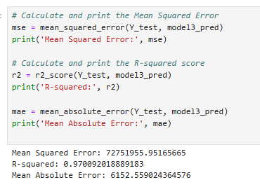
MODEL BUILDING

Slide 15
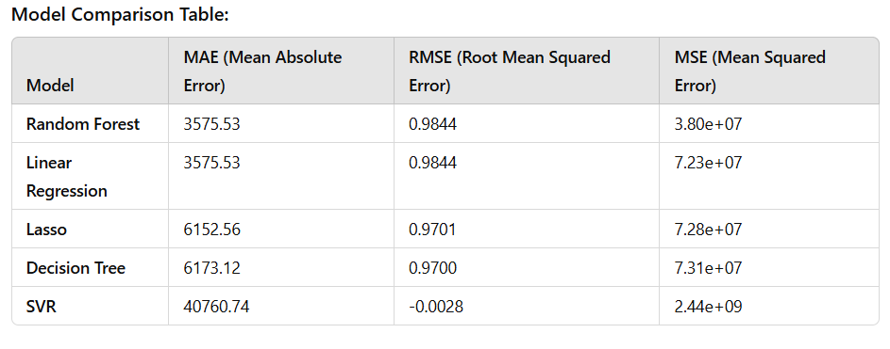
MODEL Comparison

Slide 16
MODEL COMPARISON
Insights from Model Comparison:
Best Model: Random Forest
Random Forest outperforms all other models with the lowest MAE (3575.53) and RMSE (0.9844), along with the smallest MSE (3.80e+07), indicating it provides the most accurate predictions.
Linear Regression:
Linear Regression has the same MAE and RMSE as Random Forest, but its MSE is higher (7.23e+07), suggesting it’s less effective at minimizing prediction errors in squared terms.
Lasso and Decision Tree:
Both Lasso and Decision Tree show higher errors (MAE and RMSE), making them less reliable compared to Random Forest and Linear Regression.
SVR - The Outlier:
SVR performs poorly with an extremely high MAE (40760.74) and a negative RMSE, indicating it’s not suitable for this dataset without major adjustments.
Conclusion:
Best Model: Random Forest is the top performer.
Avoid: SVR, due to its poor performance.

Slide 17
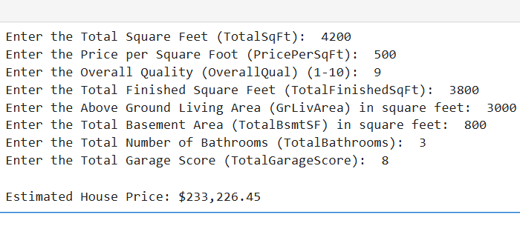
HOUSE PRICE PREDICTION MODEL

Slide 18
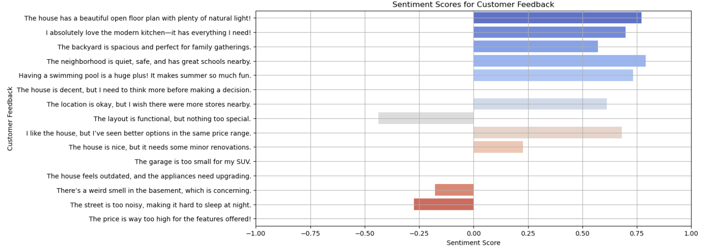
CUSTOMER FEEDBACK ANALYSIS

Slide 19
THANK YOU

